Slide 1
Managing Packages and Software
Identify Package Managers
Manage RPM Packages with YUM
Manage Debian Packages with APT
Configure Repositories
Acquire Software
Build Software from Source Code
Troubleshoot Software Dependency Issues

Slide 2
Package Managers
Programs that install, update, inventory, and uninstall packaged software.
Alternative is to compile software from source code.
Common in Linux due to open nature.
Package managers govern software lifecycle.
Control what is installed.
Manage versions.
Enable easy uninstalling.
Package is a collection of files needed by program to run.
Pre-compiled app.
Supporting files.
Supporting documentation.

Slide 3
Software Dependencies
Many Linux apps are modular and depend on other software.
Packages list dependencies.
Required components.
Software will not run without them.
Package managers check for dependencies before installing.
"Failed dependency" errors may arise.

Slide 4
Red Hat Installation vs. Debian Installation vs. Compiling (Slide 1 of 2)
Two dominant package managers:
Red Hat Package Manager (RPM)
Debian Package (dpkg)
Different design, but similar functionality.
Choice depends on distro.
Compiling is a traditional alternative.
Enables users to make changes to code before installing.
Can customize software to your liking.
Takes more effort and knowledge.

Slide 5
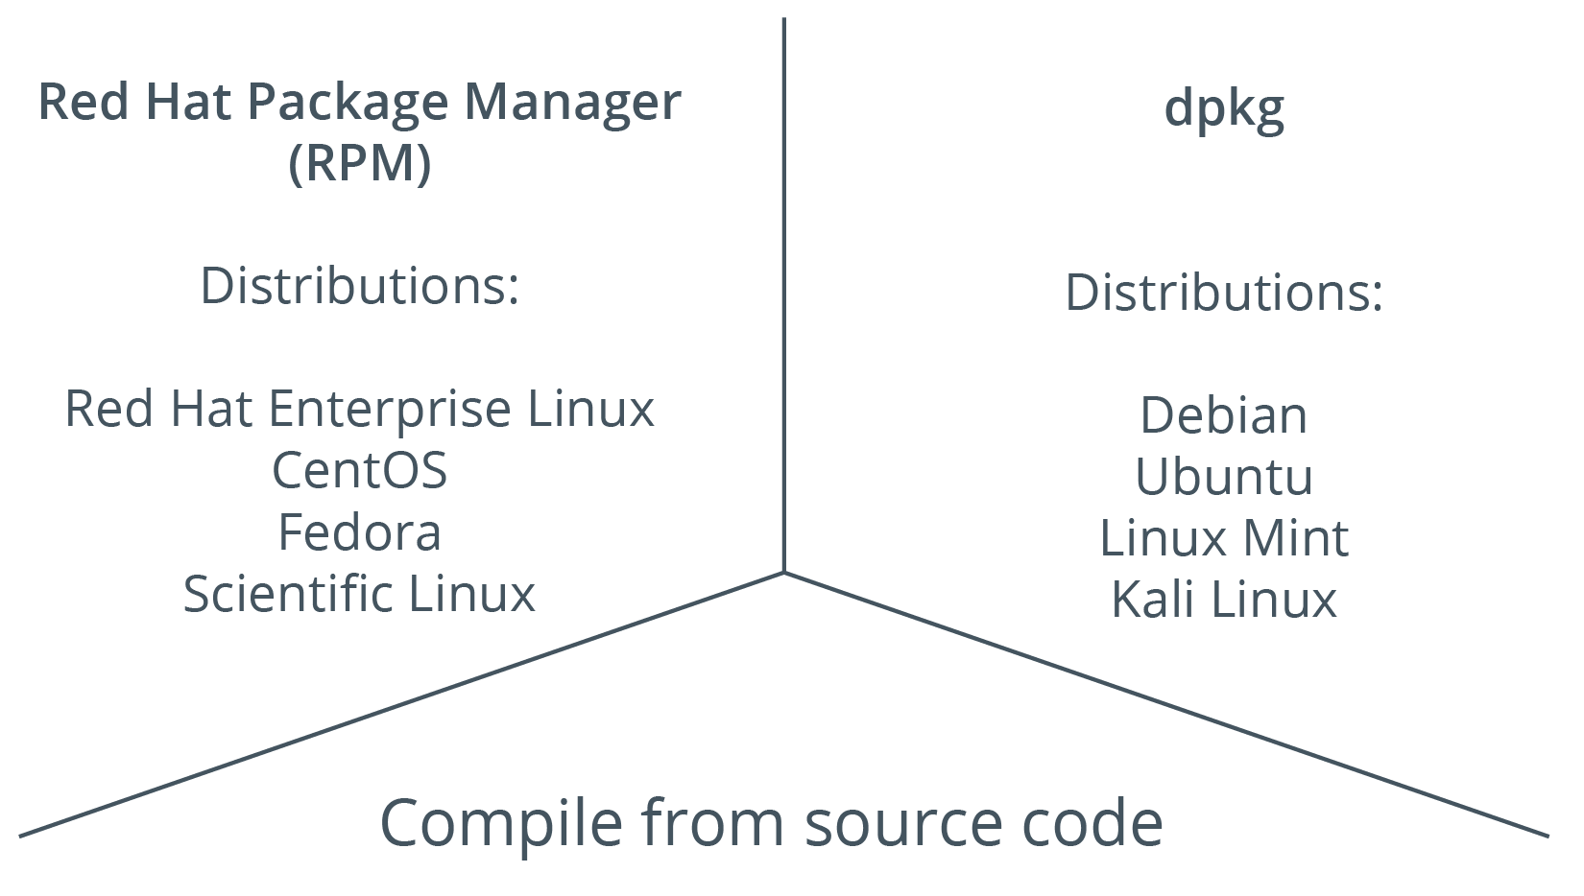
Red Hat Installation vs. Debian Installation vs. Compiling (Slide 2 of 2)

Slide 6
Red Hat Package Managers
Packages prepared by RPM use .rpm extension.
RPM is flexible and powerful.
Can inventory software easily.
YUM is newer.
Relies on .rpm packages.
More elegant and flexible commands.
Greater dependency handling.
Preferred in most cases.

Slide 7
Debian Package Managers
Packages prepared by dpkg use .deb extension.
dpkg can control entire software lifecycle.
APT is newer.
Relies on .deb packages.
More flexible.
Preferred in most cases.

Slide 8
DNF and Zypper
DNF:
Improved version of YUM.
Uses fewer resources.
Supports RPM.
Simplified commands.
Most YUM subcommands still usable.
Zypper:
Supports dependency solving.
Supports lifecycle management.
Used in openSUSE.
Supports .rpm packages.
Excellent at package management.

Slide 9
Discussing Package Managers

Slide 10
Activity: Identifying Package Managers
Develetech will use CentOS and Ubuntu servers.
You need to configure package management solutions for both.
You'll decide which are most appropriate.

Slide 11
The rpm Command (Slide 1 of 2)
Manages RPM packages.
Option | Used To
-i {package name} | Install the specified software.
-e {package name} | Uninstall the package.
-v | Enable verbose mode.
-h | Print hash marks as a progress bar.
-V {package name} | Verify software components of package exist.

Slide 12
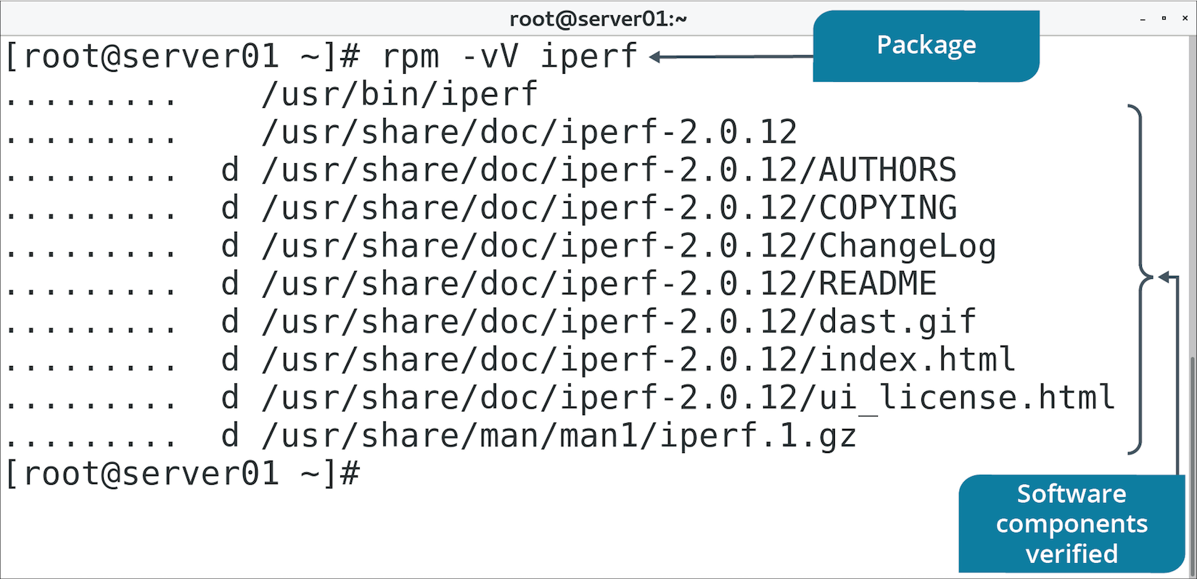
The rpm Command (Slide 2 of 2)

Slide 13
RPM Querying (Slide 1 of 2)
Use to maintain a database of software info.
Command | Used To
rpm -qa | List all installed software.
rpm -qi {package name} | List information about a package.
rpm -qc {package name} | List configuration files for a package.

Slide 14
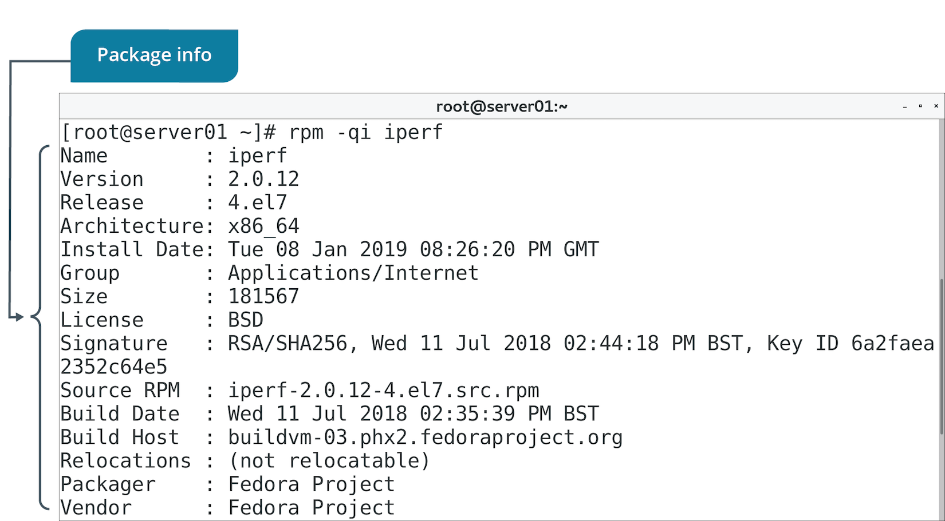
RPM Querying (Slide 2 of 2)

Slide 15
RPM Verification
Checks if installed components match what should be installed.
Used in troubleshooting to ensure package is installed and valid.

Slide 16
RPM Upgrades
-U option upgrades installed package.
Installs package if it isn't already.
-F option freshens installed package.
Upgrades but doesn't install package if it isn't already.

Slide 17
The yum Command (Slide 1 of 2)
Improves on rpm command.
Provides more straightforward management.
Can handle software dependencies.
Installs package and any packages it needs.
Can uses repositories.
Store .rpm files.
Enable admins to maintain version control.

Slide 18
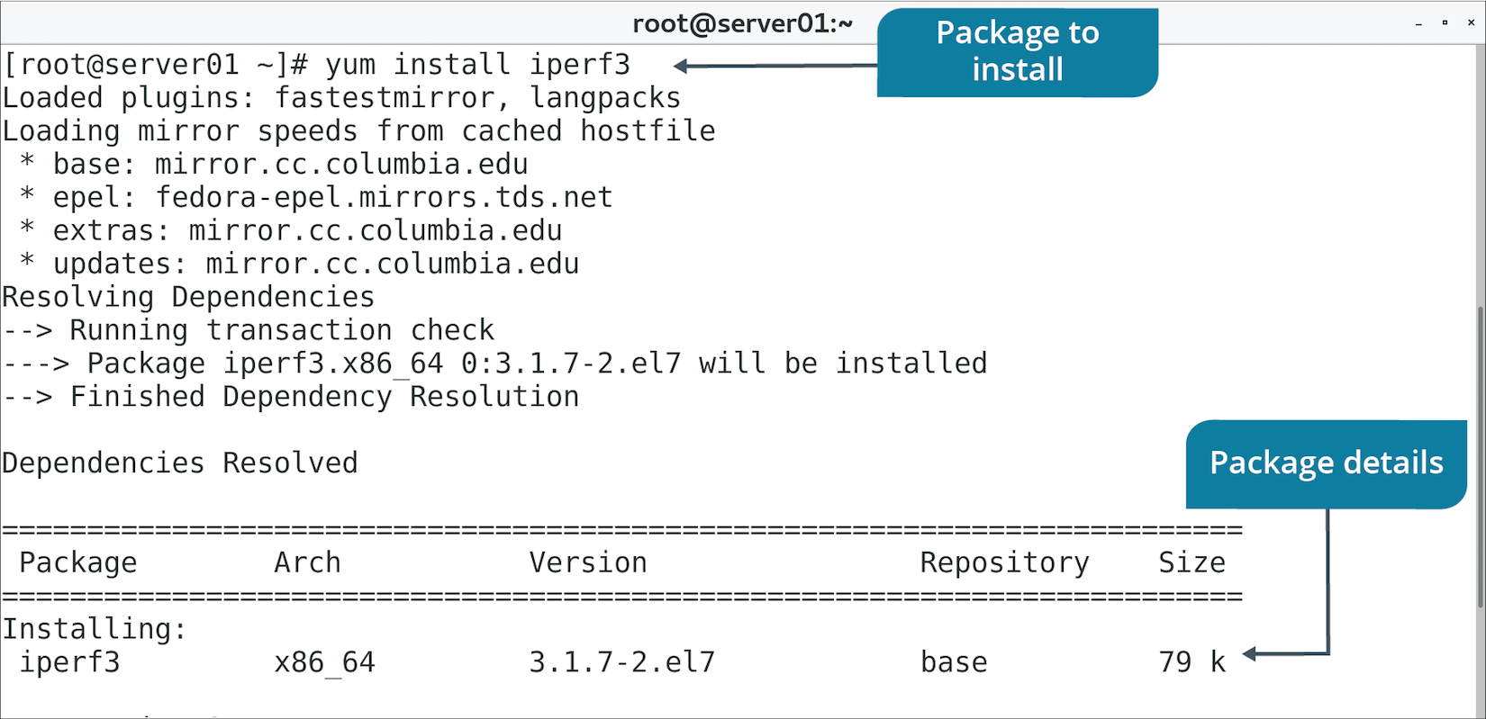
The yum Command (Slide 2 of 2)

Slide 19
yum Subcommands
Subcommand | Used To
install {package name} | Install package from any configured repository.
localinstall {package name} | Install package from local repository.
remove {package name} | Uninstall package.
update [package name] | Update package or all installed packages if no argument given.
info {package name} | Report info about package.
provides {file name} | Report what package provides specified files.

Slide 20
Discussing Managing Software with RPM and YUM

Slide 21
Activity: Managing Software with RPM and YUM
You've been asked to demo software management on CentOS.
You'll install KornShell RPM.
You'll install Very Secure FTP with YUM.

Slide 22
The dpkg Command
Manages Debian packages.
Option | Used To
-i {package name} | Install the package.
-r {package name} | Uninstall the package.
-l [package name] | List info about package or all packages if no argument given.
-s {package name} | Report whether package is installed.

Slide 23
The apt Command
APT is front-end to dpkg, like YUM to RPM.
Most common way to manage .deb packages.
Common tools in the format apt-*
apt-get, apt-cache, etc.
Older style.
Newer command is simply apt
More streamlined.

Slide 24
apt Subcommands
Subcommand | Used To
install {package name} | Install package.
remove {package name} | Uninstall package, leaving behind config files.
purge {package name} | Uninstall package, removing config files.
show {package name} | Report info about package.
version {package name} | Display version info about package.
update | Update the APT database of available packages.
upgrade [package name] | Upgrade package or all packages if none provided.

Slide 25
Debian Package Upgrades
apt update updates APT database.
APT becomes aware of new versions from repositories.
Doesn't install any software.
apt upgrade upgrades all installed software.
Based on newer versions of packages in APT database.
Can be time-consuming.
You can specify individual packages to upgrade rather than all.
Run apt update first, then apt upgrade after.

Slide 26
Discussing Managing Software with dpkg and APT

Slide 27
Activity: Managing Software with dpkg and APT
Some Develetech systems are Debian-based.
They need to undergo network troubleshooting.
You'll download and install the nmap package.
You'll use dpkg and APT.

Slide 28
Repositories (Slide 1 of 2)
A storage location for software packages.
Local:
Stored on system's storage drive.
Installation is easy, but version control difficult.
Centralized internal:
Stored on one or more systems in a LAN.
Version control is simpler.
Vendor:
Maintained on Internet.
Version control is managed by vendor.

Slide 29
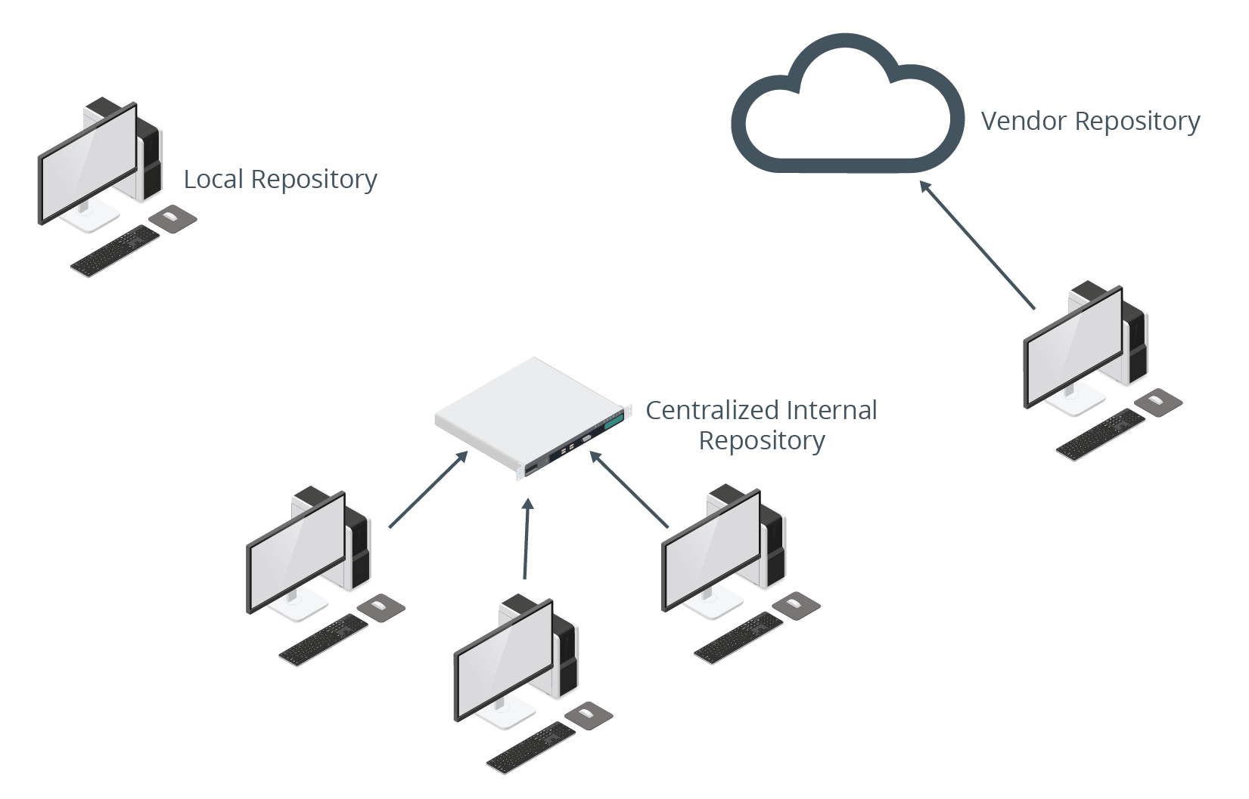
Repositories (Slide 2 of 2)

Slide 30
YUM Repository Configuration
Designate a location as a repo using createrepo
Updates XML files used to reference location.
Can be local drive, centralized server, or Internet-based.
Create .repo config file in /etc/yum.repos.d/
[repo-name]
name=Repository Name
baseurl=
enabled=1
gpgcheck=0

Slide 31
Repository Synchronization
YUM can sync online repo to local repo.
Also known as mirroring.
Reduces WAN traffic and lessens load on parent repo.
reposync is used to manage process.
You can sync parent repo once, or periodically.
Example: Sync RHN repo to local server.
RH servers can use local repo instead of going out to Internet.
Local repo might be updated nightly.

Slide 32
APT Repository Configuration
Repos are configured in:
/etc/apt/sources.list
/etc/apt/sources.list.d/
Can be local, centralized, or hosted on the Internet.
Format of entries:
deb URL distro-name components
Run apt update so APT knows about new repos.

Slide 33
Discussing Configuring Repositories

Slide 34
Activity: Configuring Repositories
Version control is a concern at Develetech.
Develetech wants to manage an internal repo for packages.
You'll configure a local YUM repo.
You'll make the repo available on the network using Apache.

Slide 35
Download Sites
Easy to download software from app vendors.
Also many sites that centralize software from different vendors.
Example software downloadable from the Internet:
Audacity
Atom
GIMP
Nmap
Can also search open source sites like GitHub for software.

Slide 36
The wget and curl Commands
You can access websites from the CLI.
Useful when you know the URL.
wget and curl can be written into scripts.
Automates the downloading process.
wget example:
wget http://download.samba.org/pub/samba/samba-latest.tar.gz
curl example:
curl -o nmap-7.70.tar.bz2 https://nmap.org/dist/nmap-7.70.tar.bz2

Slide 37
.tar Files
tar is an archiver.
Bundles multiple files together (tarball).
Creates file with .tar extension.
Makes downloading files easier.
Admin can create a bundle of files for others to extract.
Example tarball creation:
tar -cvf tarball.tar file1 file2 file3

Slide 38
tar Command Options
Option | Used To
-c | Create tarball.
-x | Extract tarball.
-v | Enable verbose mode.
-r | Append files to tarball.
-t | Test tarball or list files in tarball.
-f | Specify name of tarball in next argument.

Slide 39
Compressed Files
File compression reduces file size.
More efficient for downloading.
Several compression utilities available.
gzip, bzip2, etc.
Compressed tarball takes on file extensions like:
.tar.gz
.tar.bz2
gzip command examples:
gzip {file name}
gzip -d {file name}

Slide 40
Discussing Acquiring Software

Slide 41
Activity: Acquiring Software
You are investigating ways to download software from the web.
You're considering a script to automate the process.
You'll use wget and curl to try downloads manually.

Slide 42
Why Compile?
Vendor-packaged software is configured with generic settings.
You might want to modify those settings or the software itself.
Example: Optimize for use on specific hardware.
Compiling software is common in Linux.
For Windows and macOS, most software is pre-compiled.

Slide 43
Compilers
Compiling software requires a compiler.
Translates source code into machine-readable binaries.
GCC is a common Linux compiler.
Libraries might be required.
Vary by software.
Developers usually list required libraries.
Header files (.h) or library files (.a).

Slide 44
Libraries
Chunks of compiled code that can be used in programs to accomplish specific common tasks.
Shared libraries:
Enable modular program builds.
Reduce compilation time.
Compiled software must access necessary libraries while running.
Typically installed with distro.
General libraries are in /usr/lib/
Libraries for essential binaries are in /lib/
Sometimes included with program if not packaged with distro.

Slide 45
The ldd Command (Slide 1 of 2)
Enables users to view shared library dependencies for an app.
Useful for troubleshooting.
Useful for gathering system requirement info for an app.

Slide 46
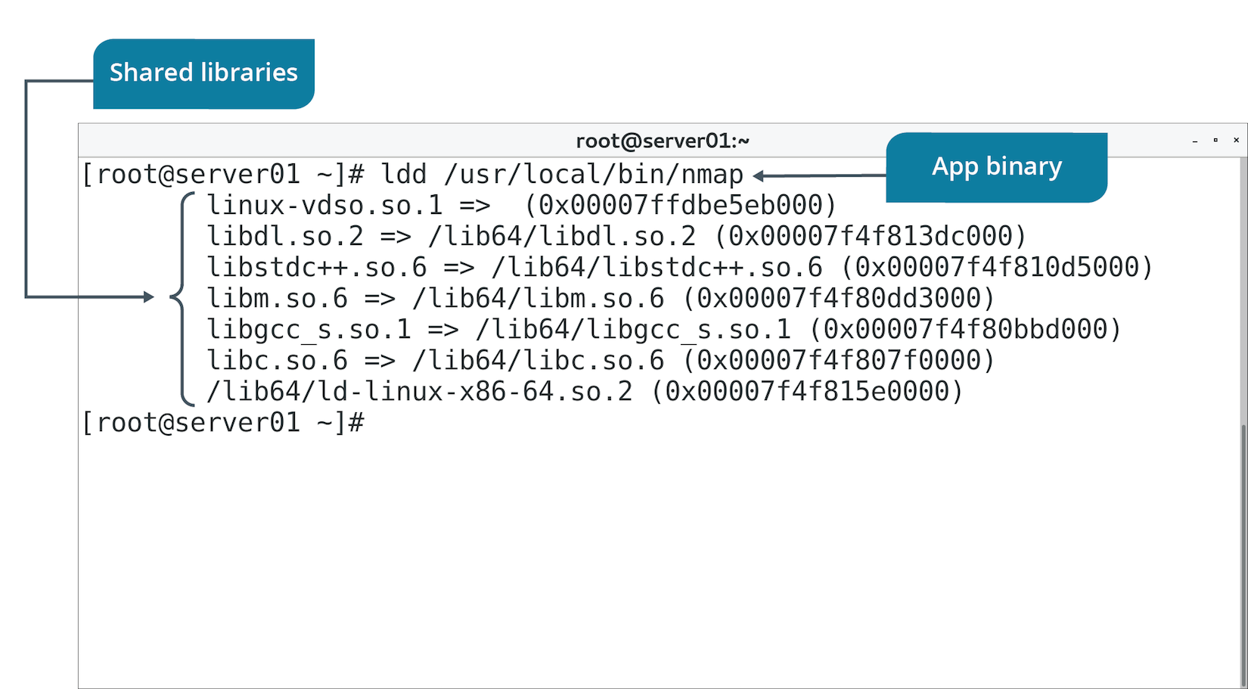
The ldd Command (Slide 2 of 2)

Slide 47
The Software Compilation Process
Unpack the download.
Change into created directory.
Run ./configure to create a makefile.
Use make to compile app based on makefile info.
Use make install to install app binaries.
Instructions may vary depending on software.
Example: Modifying makefile before make is run to optimize software.
Review README for info.

Slide 48
Discussing Building Software from Source Code

Slide 49
Activity: Compiling and Installing an Application
Develetech wants to rely on Nmap to troubleshoot networked systems.
Compiling Nmap from source enables greater flexibility.
You'll do a basic compile of Nmap.

Slide 50
Dependency Troubleshooting
Discover what packages exist before deployment.
Ensure needed dependencies are in repos.
To troubleshoot repos:
Verify network access.
Check repo configs (e.g., in /etc/yum.repos.d/)
When compiling:
Verify compiler and compiler version.
Confirm you have supporting libraries.

Slide 51
How YUM and APT Manage Dependencies
Both rely on info inside package to discover dependencies.
Both search repo for additional packages that are needed.
Can be configured to automatically install dependencies.
Simplifies installation process.

Slide 52
Guidelines for Troubleshooting Software Dependency Issues (Slide 1 of 2)
Software Dependencies/Repos:
Use rpm -V {package name} to verify components are installed.
Use rpm -qR {package name} or yum deplist {package name} to discover dependencies on RH.
Use apt-cache depends {package name} to discover dependencies on Debian distros.
Use repos and ensure dependencies are in repos.
Ensure repos are current.
Ensure connectivity to repos.
Patching/Update Issues:
Read patch docs before applying.
Ensure network connectivity.
Test patches/updates before deploying.
Ensure dependencies/versions are satisfied for patches/updates.
Check installation logs if there are issues.
Have a contingency plan in case patches cause problems.

Slide 53
Guidelines for Troubleshooting Software Dependency Issues (Slide 2 of 2)
GCC/Library Issues:
Check docs for required GCC or other compiler versions.
Verify required versions of kernel and dependencies.
Use ldd to check for shared library dependencies.
Verify library file versions/availability.
Compile/test program in VM.
Assume root privileges when issuing make install command.

Slide 54
Discussing Software Dependency Issues

Slide 55
Activity: Troubleshooting Dependency Issues
Develetech wants to ensure package managers are used effectively.
You'll answer the following questions to clarify the proper use of tools.

Slide 56
What packages might you need to install in your organization? Which package management tools will you use most often?
As an administrator, why might you create your own repositories?

